Slide 1
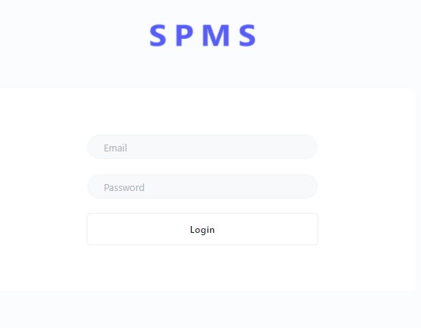
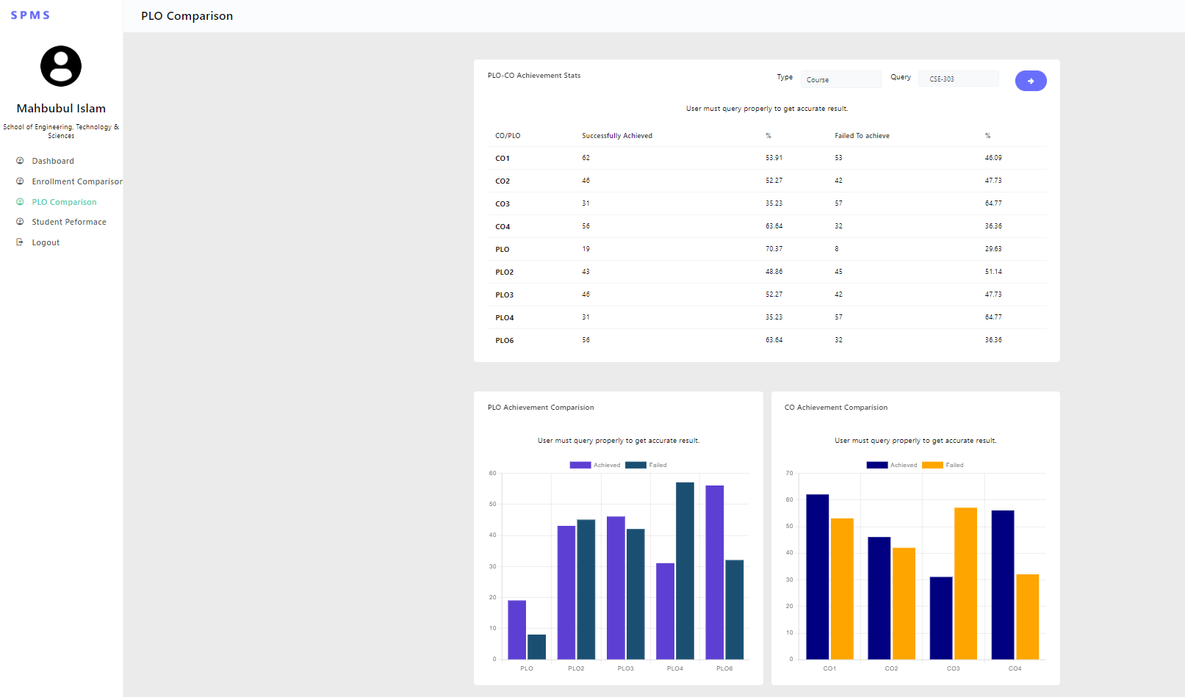
SPMS Presentation
CSE303: Database Management System
Instructors:
Ms. Sadita Ahmed
Md. Abu Sayed

Slide 2
Group 7 coder buddis
ID | NAME
1830221 | Md.Abubakkar Siddik
1921662 | Adnan Rahman Sharon
1831110 | Md.Ashikur Rahman
1831003 | Saif Islam Anik
1921430 | Shahadatul Islam

Slide 3
Scope of the project More effective system CO and PLO performed Generate performance reports Can use any university

Slide 4


Rich Picture
Existing System

Slide 5
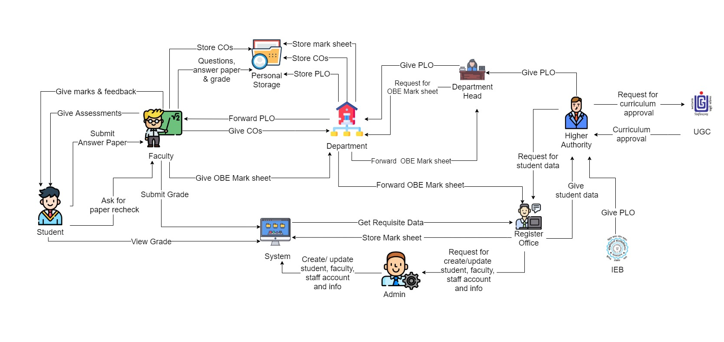

Slide 6
Problem?
Manual CO,PLO mapping
Cannot monitor student performance
Question bank are manually stored

Slide 7

Rich Picture
Proposed System

Slide 8
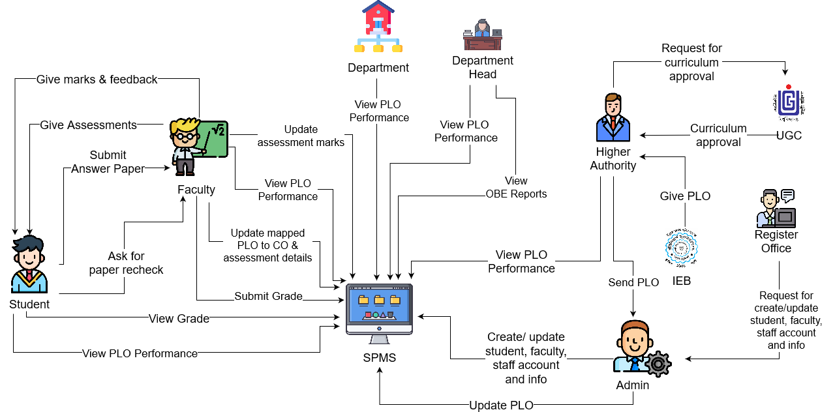

Slide 9

Proceed
Monitor student performance
Automatic PLO,CO mapping
Other university can log in

Slide 10

ERD DIAGRAM

Slide 11
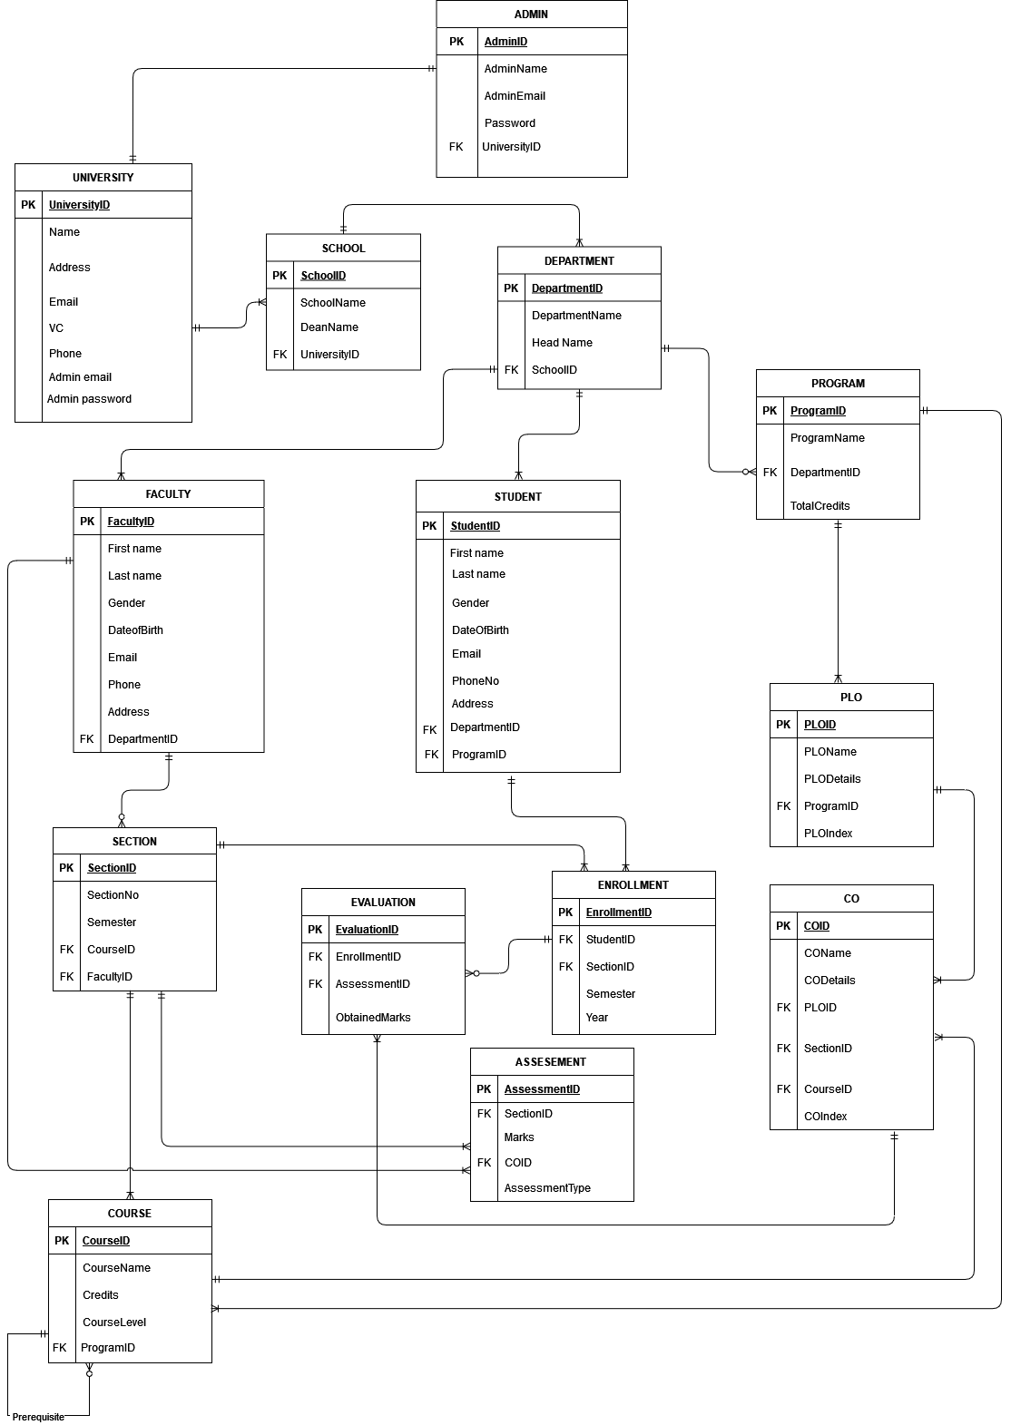

Slide 12





System User
Admin
Superuser
Dean
Faculty
Student

Slide 13
Input forms
Create Assignment
Add Evaluation File
PLO of the Program
CO of the Course

Slide 14
Output reports
PLO achievement comparison.
CO achievement comparison.
PLO percentage comparison.
Course wise PLO achievement.
Department & Program wise comparison.
Course wise performance trend.

Slide 15
Conclusion
The system will automatically map initial COs with PLOs .
The system is user friendly with less human involvement.
Store information and analysis.
The system can be used by other universities as well.

Slide 16
Cout <<“Thank you ☺ ‘’ << endl;

